Slide 1
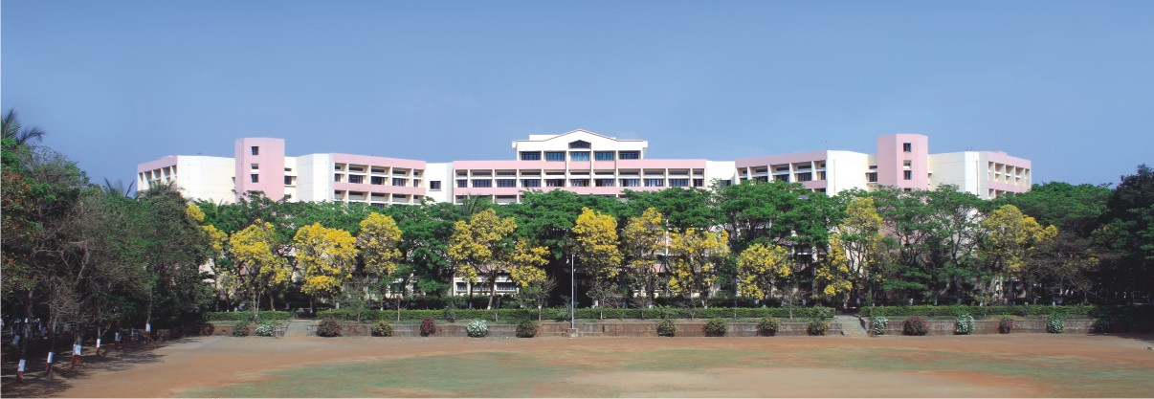

Software Engineering & Project Management
Notes:
NOTE:
To change the image on this slide, select the picture and delete it. Then click the Pictures icon in the placeholder to insert your own image.

Slide 2
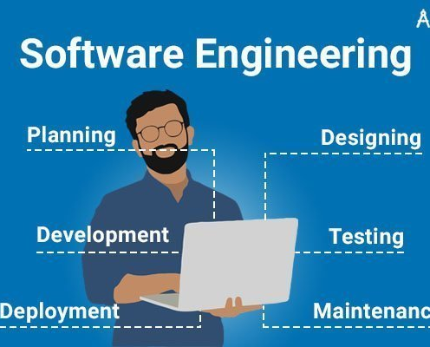
Unit 1
Introduction to Software Engineering and Software Process Models

Slide 3
Contents
Software Engineering :
The Nature of Software, Defining Software, Software Engineering Process, Software Engineering Practice.
Process Models:
A Generic Process Model, Process Assessment and Improvement, Prescriptive Process Models.
Agile Development:
Agility, Agility and cost of change, Agile Process, Extreme Programming (XP), Other Agile process models.

Slide 4
What is Software?
Software is:
Instructions (computer programs) that when executed provide desired features, function, and performance
Data structures that enable the programs to adequately manipulate information
Documentation that describes the operation and use of the programs
Software is both a product and a vehicle that delivers a product(e.g. Operating System)

Slide 5
What is Software?
A collection of computer programs and related documents that are intended to provide desired features, functionalities and better performance.
Software products maybe –
Generic: developed to be sold to a range of different customers
Custom: developed for a single customer according to their specification

Slide 6
The Nature of Software
System software
Compiler, assembler, editors
Application software
Stand-alone programs/systems
Engineering/Scientific software
Complex numeric computations viz. astronomy, space shuttle orbital dynamics, molecular biology, system simulation etc.
Embedded software
Program residing in another product or system
Web applications
Web pages
Artificial intelligence software
Robotics, expert systems, game playing, image and speech recognition

Slide 7
Characteristics of Software
Software is developed or engineered; it is not manufactured in the classical sense
Software doesn’t “wear out”
Although the industry is moving toward component-based construction, most software continues to be custom built

Slide 8

Software Engineering - A Layered Technology
Figure: Software Engineering Layers

Slide 9
Software Engineering - A Layered Technology
Quality: Organizational commitment to quality, Total Quality Management (TQM), Six Sigma etc.
Process Model : A framework responsible for the context in which technical methods are applied, work products are produced, milestones are established, quality is ensured, and change is properly managed.
Methods: A broad array of tasks that include communication, requirements analysis, design modeling, program construction, testing, and support.
Tools : Automated or semi automated support for process and methods.

Slide 10
The Software Engineering Process
Software processes in software engineering refer to the methods and techniques used to develop and maintain software.
A process is a collection of activities, actions and tasks to create a work product.
An activity strives to achieve a broad objective. For example, communication with stakeholders.
An action encompasses a set of tasks that produce a major work product. For example, architectural design.
A task focuses on a small, but well-defined objective that produces a tangible outcome. For example, conducting a unit test.
The intent is to deliver software in a timely manner with sufficient quality to satisfy end user.

Slide 11
The Software Engineering Process
Process Framework has 5 activities:
Communication
The intent is to understand stakeholders’ objectives for the project and to gather requirements that help define software features and functions.
Planning
Defines the software engineering work by describing the technical tasks to be conducted, the risks that are likely, the resources that will be required, the work products to be produced, and a work schedule
Modeling
A software engineer create models to better understand software requirements and the design that will achieve requirements.
Construction
This activity combines code generation (either manual or automated) and the testing that is required to uncover errors in the code
Deployment
The software (as a complete entity or as a partially completed increment) is delivered to the customer who evaluates the delivered product and provides feedback based on the evaluation

Slide 12
Umbrella Activities
Umbrella activities are applied throughout a software project and help to manage and control progress, quality, change, and risk.
Software project tracking and control—allows the software team to assess progress against the project plan and take any necessary action to maintain the schedule.
Risk management—assesses risks that may affect the outcome of the project or the quality of the product.
Software quality assurance—defines and conducts the activities required to ensure software quality.
Technical reviews—assesses software engineering work products in an effort to uncover and remove errors before they are propagated to the next activity

Slide 13
Umbrella Activities
Measurement—defines and collects process, project, and product measures that assist the team in delivering software that meets stakeholders’ needs; can be used in conjunction with all other framework and umbrella activities.
Software configuration management— manages the effects of change throughout the software process.
Reusability management—defines criteria for work product reuse (including software components) and establishes mechanisms to achieve reusable components.
Work product preparation and production —encompasses the activities required to create work products such as models, documents, logs, forms, and lists.

Slide 14
Software Engineering Practice
Outline of the essence of problem solving and consequently the essence of Practice:
Understand the problem
communication & analysis
Plan the solution
modeling and software design
Carry out the plan
code generation
Examine the result
testing and quality assurance

Slide 15
Process models

Slide 16
Contents
Software Engineering Fundamentals:
Introduction to software engineering, The Nature of Software, Defining Software, Software Engineering Practice.
Software Process:
A Generic Process Model, defining a Framework Activity, Identifying a Task Set, Process Patterns, Process Assessment and Improvement, Prescriptive Process Models, The Waterfall Model, Incremental Process Models, Evolutionary Process Models, Concurrent Models, A Final Word on Evolutionary Processes, Unified Process, Agile software development: Agile methods, plan driven and agile development.

Slide 17
What is process model ?
A process model provides a specific roadmap for software engineering work.

Slide 18
Generic Process Model
Process means a series of activities taking place .
A process was defined as a collection of work activities, actions, and tasks that are performed when some work product is to be created.

Slide 19
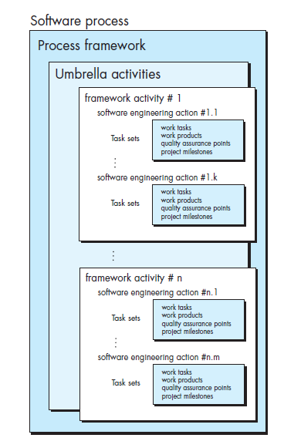
Generic Process Models

Slide 20
Process Framework Activity :-
includes planning, modeling, construction, and deployment.
Umbrella activities :
project tracking and control, risk management, quality assurance, configuration management , technical reviews, and others—are applied throughout the process.

Slide 21

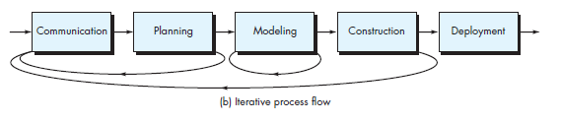
Process Flow

Slide 22
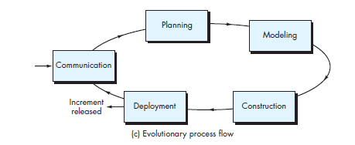
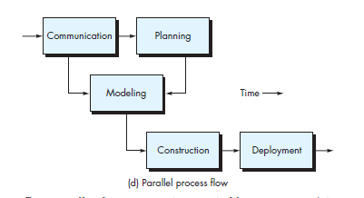

Slide 23
Prescriptive process models
A prescriptive process model is a model that describes "how to do" according to a certain software process system.
A prescriptive model prescribes how a new software system should be developed.
Prescriptive models are used as guidelines or frameworks to organize and structure how software development activities should be performed, and in what order.

Slide 24
Types of Prescriptive process models
Waterfall model
Incremental Model
Evolutionary Process models
Prototyping Model
Spiral Model
Concurrent Models
A final World on Evolutionary Process

Slide 25
Waterfall model
The waterfall model is also called as 'Linear sequential model' or 'Classic life cycle model'.
In this model, each phase is fully completed before the beginning of the next phase.
This model is used for the small projects.
In this model, feedback is taken after each phase to ensure that the project is on the right path.
Testing part starts only after the development is complete.

Slide 26
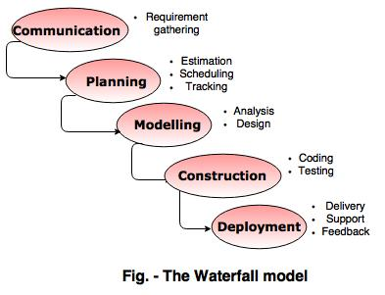
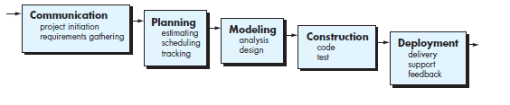
Waterfall Model

Slide 27
Advantages of waterfall model
The waterfall model is simple and easy to understand, implement, and use.
All the requirements are known at the beginning of the project, hence it is easy to manage.
It avoids overlapping of phases because each phase is completed at once.
This model works for small projects because the requirements are understood very well.
This model is preferred for those projects where the quality is more important as compared to the cost of the project.

Slide 28
Disadvantages of waterfall model
This model is not good for complex and object oriented projects.
It is a poor model for long projects.
The problems with this model are uncovered, until the software testing.
The amount of risk is high.

Slide 29
2. Incremental Process model
The incremental model combines the elements of waterfall model and they are applied in an iterative fashion.
The first increment in this model is generally a core product.
Each increment builds the product and submits it to the customer for any suggested modifications.
The next increment implements on the customer's suggestions and add additional requirements in the previous increment.
This process is repeated until the product is finished. For example, the word-processing software is developed using the incremental model.

Slide 30
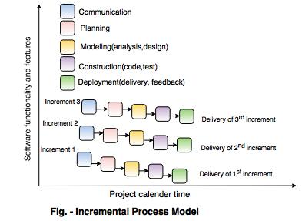
2. Incremental Process model

Slide 31
Advantages of incremental model
This model is flexible because the cost of development is low and initial product delivery is faster.
It is easier to test and debug during the smaller iteration.
The working software generates quickly and early during the software life cycle.
The customers can respond to its functionalities after every increment.

Slide 32
Disadvantages of incremental model
The cost of the final product may cross the cost estimated initially.
This model requires a very clear and complete planning.
The planning of design is required before the whole system is broken into small increments.
The demands of customer for the additional functionalities after every increment causes problem during the system architecture.

Slide 33
Evolutionary Process models
Evolutionary models are iterative.
They are characterized in a manner that enables you to develop increasingly more complete versions of the software.
This model is also known as Successive model .
Two common evolutionary process models are
Prototyping
The Spiral Model

Slide 34
Advantages of evolutionary model
User can easily understood the system and experiment with partially developed system.
Useful in identifying requirement.
It reduces the chance of error by testing core model multiple times .
Disadvantage :
If the problem is not easy to divide into module then this module cannot be implemented correctly .

Slide 35
Prototyping Model
Prototyping Model is used when the customers do not know the exact project requirements beforehand
Communication : Prototyping model starts with communication
Quick Plan : A prototyping iteration is planned quickly, and modeling occurs
The quick design leads to the construction of a prototype. The prototype is deployed and evaluated by stakeholders

Slide 36
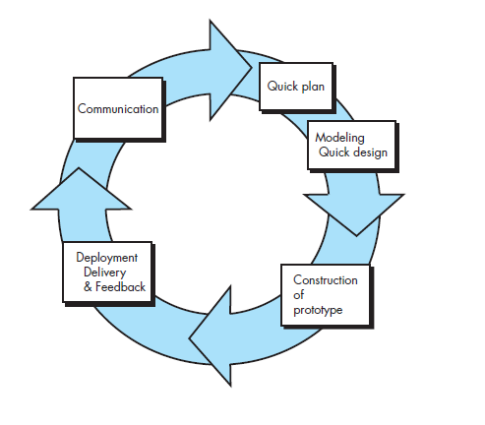
Prototyping Model

Slide 37
Advantages of Prototype Model
This model is flexible in design.
It is easy to detect errors.
We can find missing functionality easily.
There is scope of refinement, it means new requirements can be easily accommodated.
It can be reused by the developer for more complicated projects in the future.
It ensures a greater level of customer satisfaction and comfort.
It is ideal for online system.
It helps developers and users both understand the system better.
Integration requirements are very well understood and deployment channels are decided at a very early stage.
It can actively involve users in the development phase.

Slide 38
Disadvantages of Prototype Model
This model is costly.
It has poor documentation because of continuously changing customer requirements.
There may be too much variation in requirements.
Customers sometimes demand the actual product to be delivered soon after seeing an early prototype.
There may be sub-optimal solutions because of developers in a hurry to build prototypes.
Customers may not be satisfied or interested in the product after seeing the initial prototype.
There is certainty in determining the number of iterations.
There may be incomplete or inadequate problem analysis.
There may increase the complexity of the system.

Slide 39
The Spiral Model
Spiral Model is a risk-driven software development process model
It is a combination of waterfall model and iterative model.
Spiral Model helps to adopt software development elements of multiple process models for the software project based on unique risk patterns ensuring efficient development process.
The spiral model in software engineering was first mentioned by Barry Boehm in his 1986 paper.
A Spiral model in software engineering is used when project is large

Slide 40
The Spiral Model

Slide 41
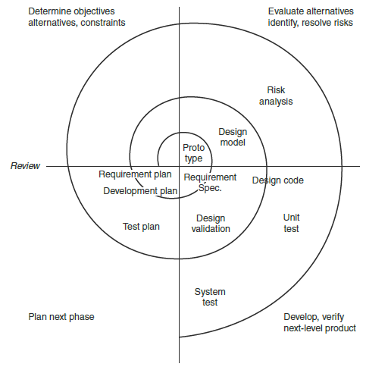
Spiral Model

Slide 42
Advantages & Disadvantages of Spiral Model
High amount of risk analysis
Useful for large and mission-critical projects.
Changing requirements can be accommodated.
Disadvantages-
Can be a costly model to use.
Risk analysis needed highly particular expertise
Doesn't work well for smaller projects.
Large number of intermediate stages requires excessive documentation.

Slide 43
Concurrent Model
The concurrent development model, sometimes called concurrent engineering, can be represented schematically as a series of framework activities, Software engineering actions of tasks, and their associated states.
The concurrent model is often more appropriate for system engineering projects where different engineering teams are involved.

Slide 44
Concurrent Model

Slide 45
Advantages & Disadvantages of Concurrent Model
This model is applicable to all types of software development processes.
It is easy for understanding and use.
It gives immediate feedback from testing.
It provides an accurate picture of the current state of a project.
It needs better communication between the team members. This may not be achieved all the time.
It requires to remember the status of the different activities.

Slide 46
A Final Word on Evolutionary Processes
The modern computer software is characterized by continual change, by very tight time lines, and by an emphatic need for customer–user satisfaction.

Slide 47
Weakness of Evolutionary model
The first concern is that prototyping [and other more sophisticated evolutionary processes] poses a problem to project planning because of the uncertain number of cycles required to construct the product . . .
Second, evolutionary software processes do not establish the maximum speed of the evolution.
the evolutions occur too fast----process will fall into chaos.
speed is too slow ---- productivity could be affected . . .
Third, [evolutionary] software processes should be focused on flexibility and extensibility rather than on high quality. This assertion sounds scary.
The intent of evolutionary models is to develop high-quality software in an iterative or incremental manner

Slide 48
Unified Processes
Unified Process is an iterative and incremental software development process framework.
The Unified Process recognizes the importance of customer
communication and streamlined methods for describing the customer’s view of a system.
It suggests a process flow that is iterative and incremental, providing the evolutionary feel that is essential in modern software development.

Slide 49
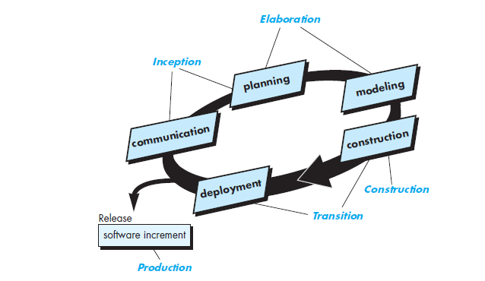
Phases of Unified process

Slide 50
Inception phase :-
Encompasses both customer communication and planning activities.
By collaborating with stakeholders, business requirements for the software are identified; a rough architecture for the system is proposed, and a plan for the iterative, incremental nature of the ensuing project is developed.
Role of Inception Phase
Vision the document
initial stage use case model
Initial business cases,
Initial Risk assessment
Project Plan

Slide 51
Elaboration phase:-
Encompasses the communication and modelling activities of the generic process model.
In this phase the five different views of the software are crated
the use case model,
the analysis model,
the design model,
the implementation model,
and the deployment model
The plan is carefully reviewed at the culmination of the elaboration phase to ensure that scope, risks, and delivery dates remain reasonable.
Modifications to the plan are often made at this time
Role of this phase
Develop the complete use case model
Analysis model
software architecture description
Project Iteration plan
Project Work flow,milestones

Slide 52
Construction phase :-
IT is identical to the construction activity defined for the generic software process.
All necessary and required features and functions for the software increment (i.e., the release) are then implemented in source code.
Role of this phase
Model integration
Test plan creation
Test cases
Support documents

Slide 53
Transition phase
It encompasses the latter stages of the generic construction activity and the first part of the generic deployment (delivery and feedback) activity.
At the conclusion of the transition phase, the software increment becomes a usable software release.

Slide 54
Production phase
It coincides with the deployment activity of the generic process.

Slide 55
What is Agile
Agile is an iterative approach to project management and software development that helps teams deliver value to their customers faster and with fewer headaches.
The main aim of Agility is customer satisfaction .
Agile team supports all sorts of changes
Changes in the software being built,
changes to the team members,
changes because of new technology,
changes of all kinds that may have an impact on the product they build or the project that creates the product.

Slide 56
It emphasizes rapid delivery of operational software and deemphasizes the importance of intermediate work products (not always a good thing);
It adopts the customer as a part of the development team and works to eliminate the “us and them” attitude that continues to pervade many software projects.
It recognizes that planning in an uncertain world has its limits and that a project plan must be flexible.

Slide 57
Agile Software development
Agile is a software development methodology to build the software incrementally using short iteration of 1 to 4 weeks so the development is aligned with the changing business needs.
The software application is actually the heart of all the business operations. So according to the rapid changing rules and business ideas, it should respond quickly .
Thus, the developer is supposed to develop the new software quickly to meet the desired requirements in the stipulated time .

Slide 58
Agile Process Model
"Agile process model" refers to a software development approach based on iterative development.
Agile team must be highly motivated ,updated with latest skillset and should focuses on development simplicity .
Important Assumptions for agile process model
Difficult to predict in advanced software requirement
Design and constructions are interleaved in most of the projects ,it is difficult to predict the design before construction .
Analysis ,design, construction and testing are not much predictable

Slide 59
Agile Methods
Agile Modelling (AM) is a collection of values, principles, and practices for modelling software that can be applied on a software development project in an effective and light-weight manner.
Agile methodology mainly focuses on the product instead of focusing on the design and documentation part .
All the agile methods trust on the incremental approach instead of conventional waterfall approach
Notes:
.

Slide 60
Plan-Driven Development
Plan-driven processes are processes where all of the process activities are planned in advance and progress is measured against this plan.

Slide 61
Agile development
In agile processes, planning is incremental and it is easier to change the plan and the software to reflect changing customer requirements.

Slide 62
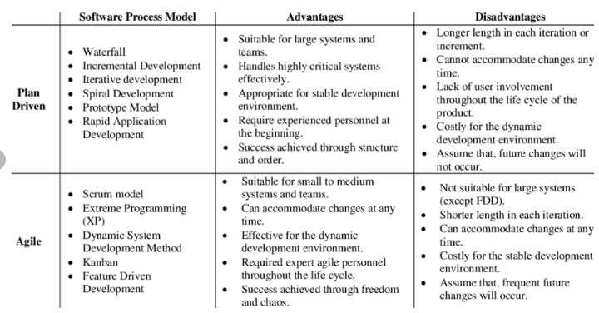

Slide 63
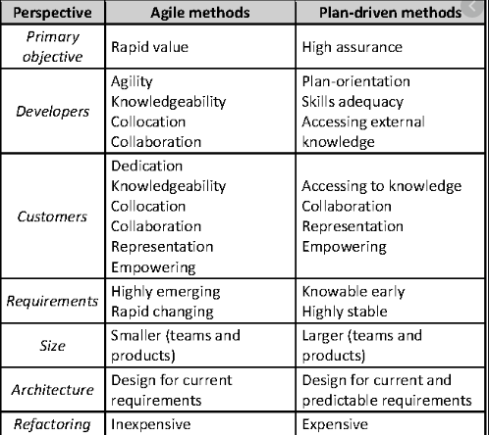
Comparison between plan-driven and agile development

Slide 64

Thank You !!
Name of Instructor: Priti Vaidya, Ashwini Dixit
Email of Instructor: ppvaidya@kkwagh.edu.in, addixit@kkwagh.edu.in
K.K.Wagh Institute of Engineering Education & Research, Nashik

